Slide 1
Twitter Sentiment and Stock Market Reactions:
Evidence from U.S. Airlines during Covid-19
Team 5: Alan Shen, Haogeng Liu, Hongyi Zhou, Xingchao Gao

Slide 2


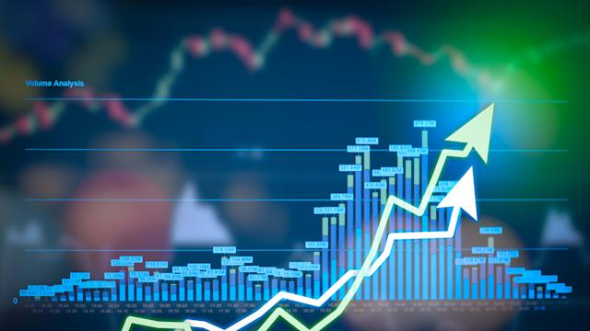
Introduction
novel?
Investor sentiment is an important factor in determining asset prices.
Twitter sentiment have significant impact for trading volume and returns, and can be helpful to predict future trading volume (Duz Tan and Tas, 2020) and stock returns (Gu and Kurov, 2020).
To understand the effectiveness of using Twitter sentiment analysis as an indicator of stock market reactions, we focus on U.S. airline companies during Covid-19.
Could Twitter sentiment predict stock market reactions, or does sentiment follow the stock performance?
Notes:
Introduction of the feasibility of the project ()

Slide 3
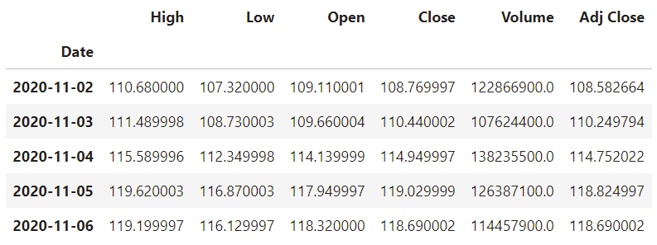
Data (Stock)
Stock list
Stock Price (Source: Yahoo Finance)
Market | Symbol | Name
NYSE | DAL | Delta Air Lines
NASDAQ | UAL | United Airlines Holdings
NASDAQ | AAL | American Airlines Group
NYSE | LUV | Southwest Airlines
NASDAQ | JBLU | JetBlue Airways
NYSE | SAVE | Spirit Airlines
Time period:
1/1/2020-12/31/2020

Slide 4
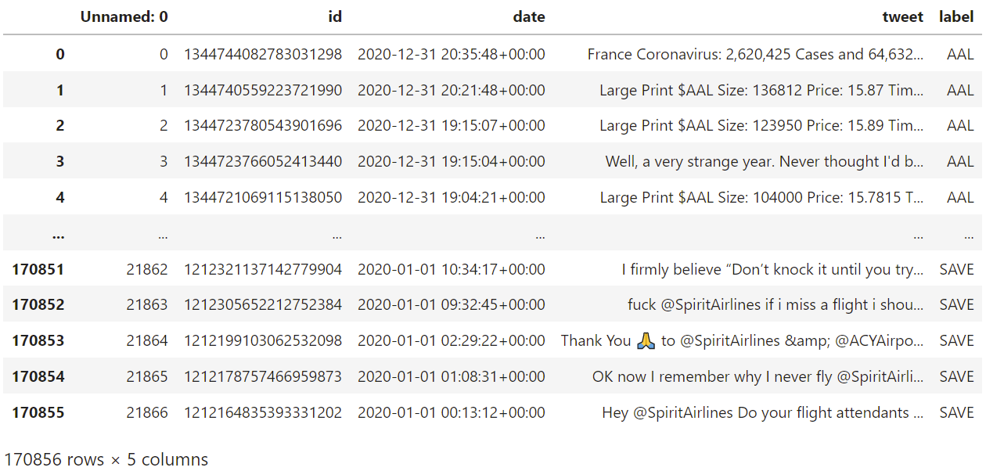
Data (Twitter)
Raw Twitter data
The preprocessing steps:
stopwords (i.e., 'the', 'a', 'and', 'how', etc.);
tweets with a question mark - questions are not good indicators of sentiment;
non-letters (including: numbers, emojis, and punctuation);
URL links;
accounts referenced using '@' symbol;
words less than 3 characters;
retweets - we decided not to count the same tweet twice;
Time period: 1/1/2020-12/31/2020
Volume: 170,856

Slide 5
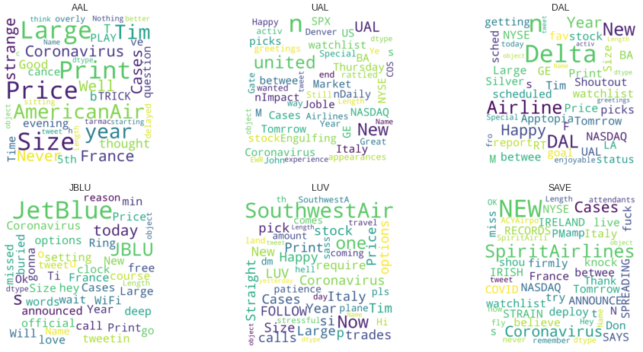
Data (Twitter)
Raw Twitter data
The term “coronavirus” appears in every airline’s word cloud.
Words expressing feelings, like “happy”, “strange” and “nothing better”, are very common.
Money and stock, like “stock”, “NASDAQ” and “price”.

Slide 6
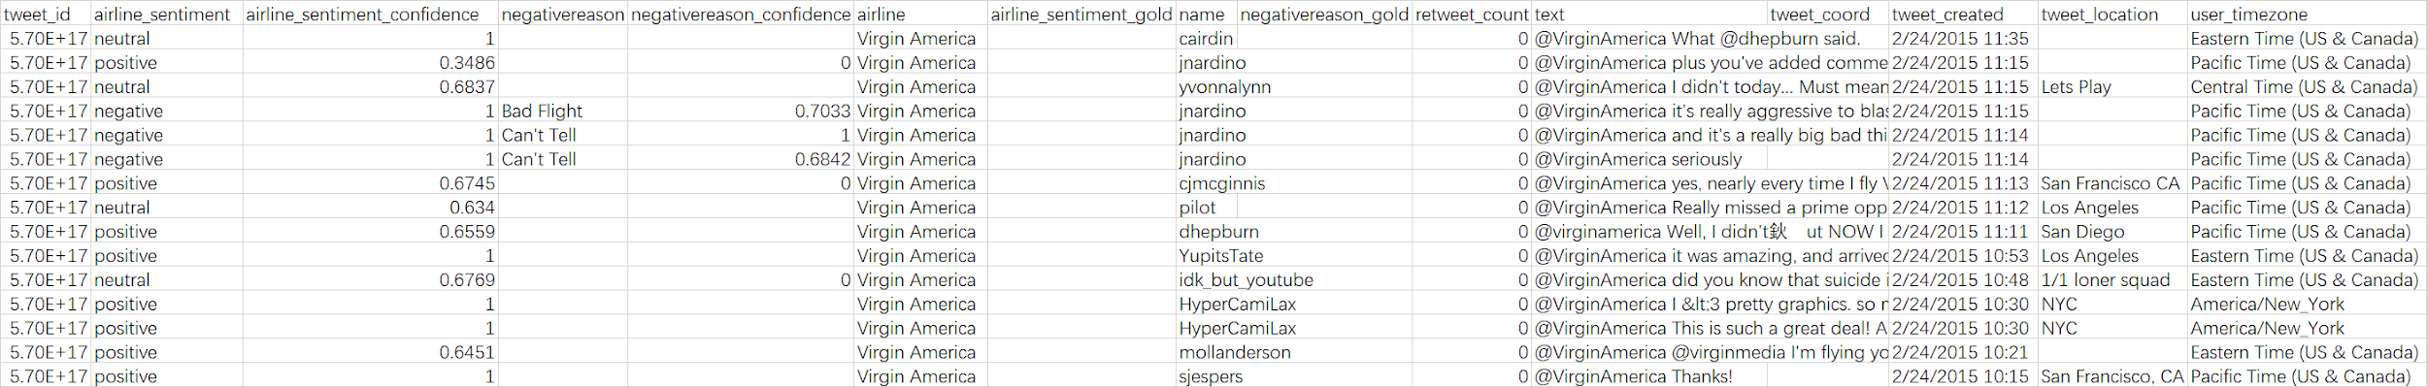
Data (Twitter)
Twitter sentiment score (training set)
To train our model to classify tweets into three sentiment categories: positive, neutral, and negative, we use a dataset from kaggle as our training set.
Volume: 14,605
Source: (https://www.kaggle.com/benhamner/exploring-airline-twitter-sentiment-data)

Slide 7
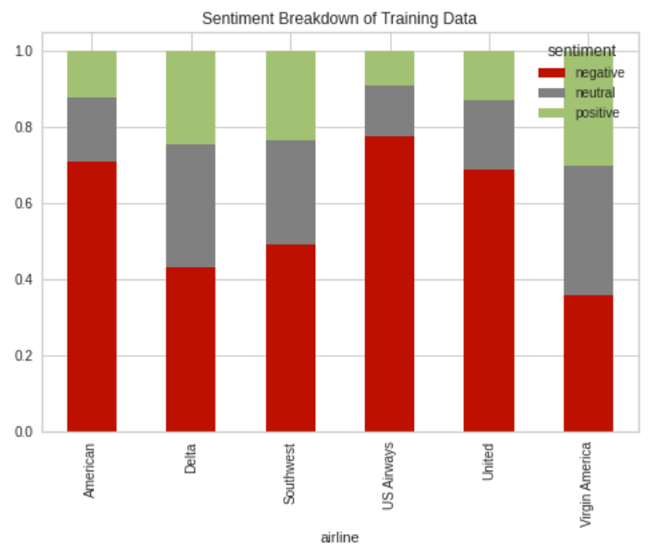
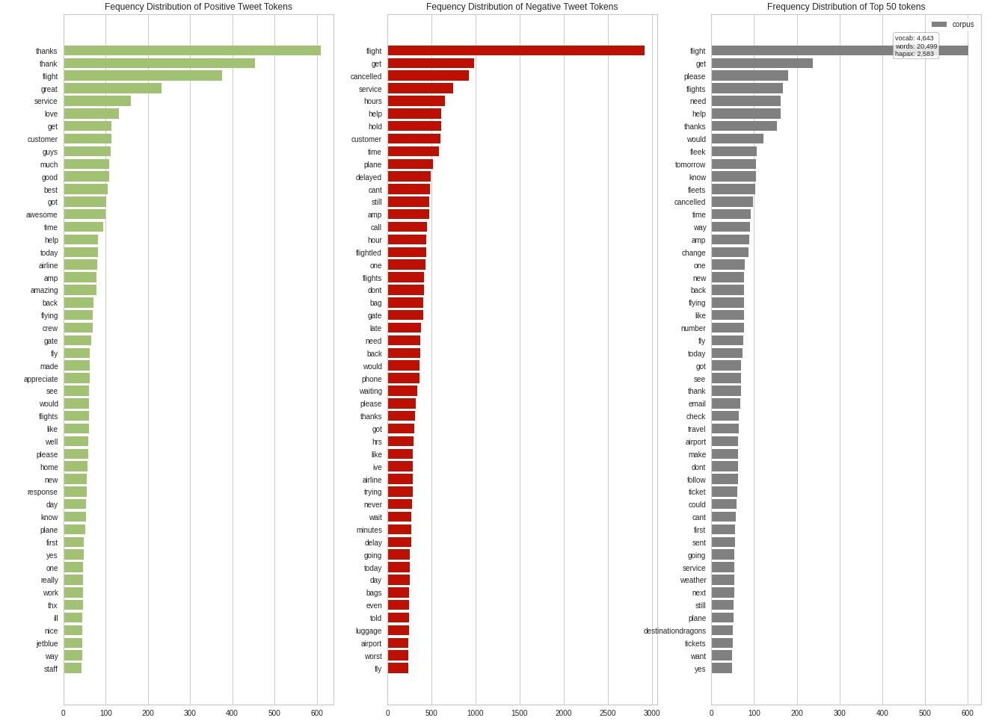
Text Analysis For Training Data
Sentiment Breakdown
Frequency Distribution

Slide 8
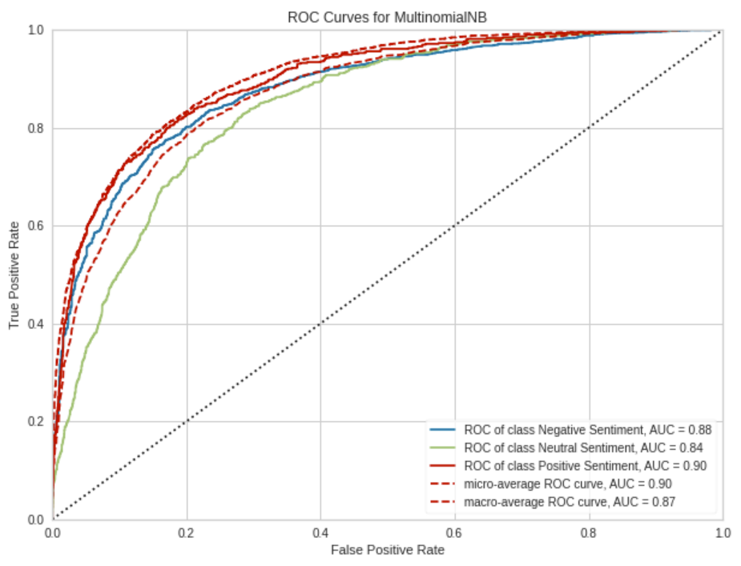
Testing the Accuracy of the Model

Slide 9
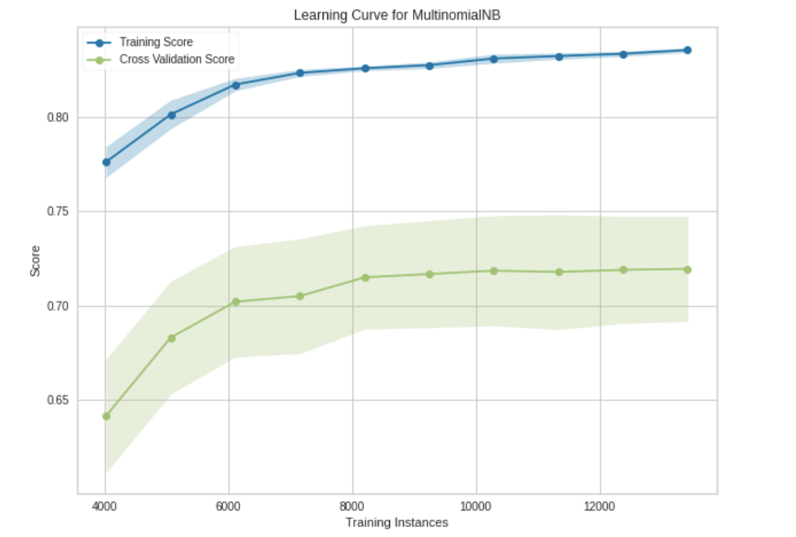
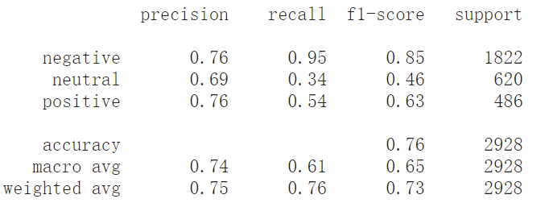
Visualizing the Classification Model (F1-Score)

Slide 10
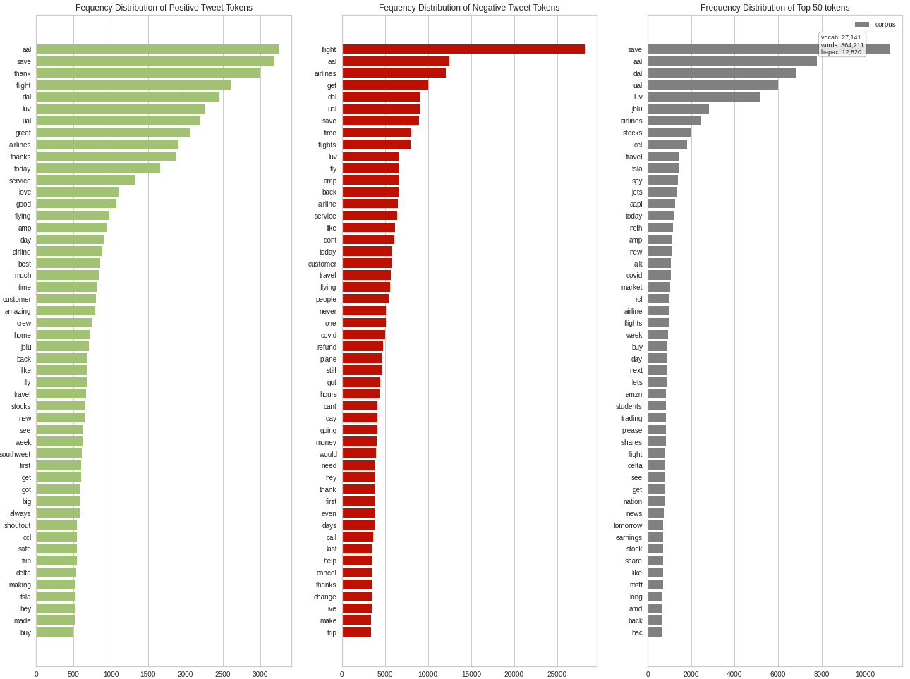
Text Analysis for Predicted Labels

Slide 11
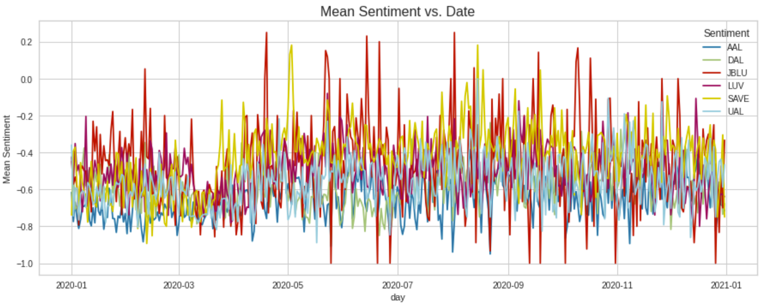
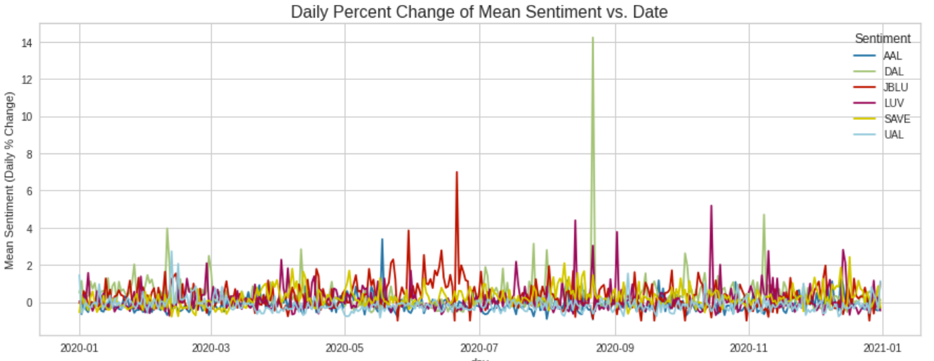
Results
Twitter Sentiment vs. Stock Price
American Airlines had the worst sentiment scores
Spirit Airlines seem to have the best sentiment scores overall
Twitter sentiment for JetBlue appears to be the most volatile

Slide 12
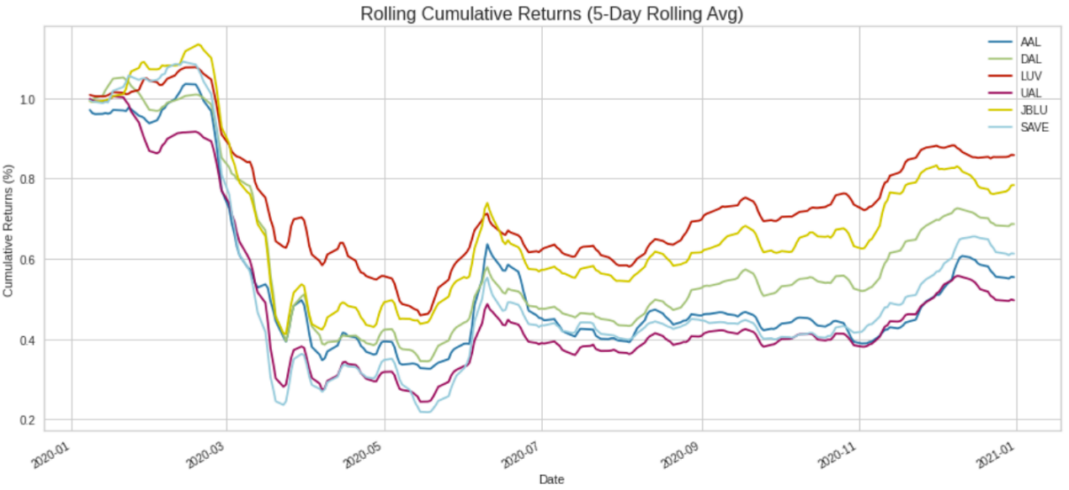
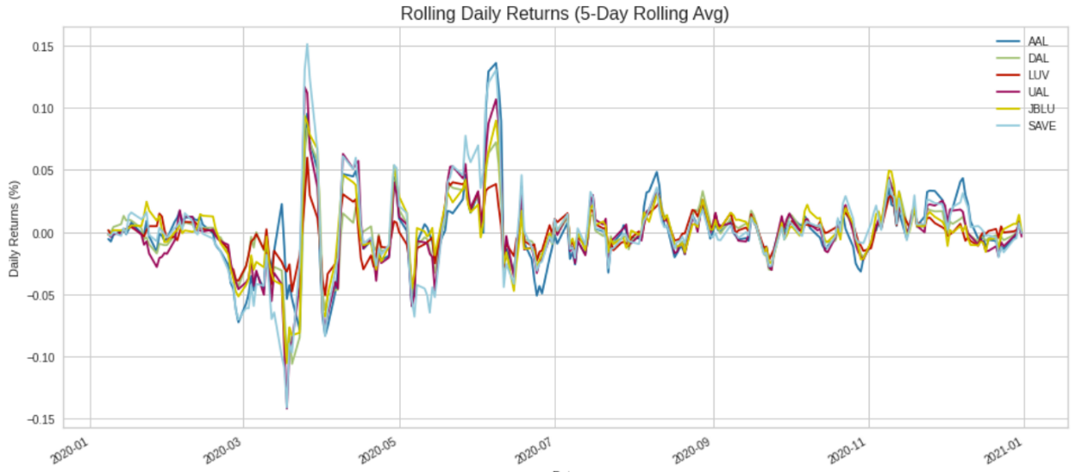
Twitter Sentiment vs. Stock Price (Cont’d)
Dip in stock prices coincides with the lowest average sentiment scores from March - June 2020

Slide 13
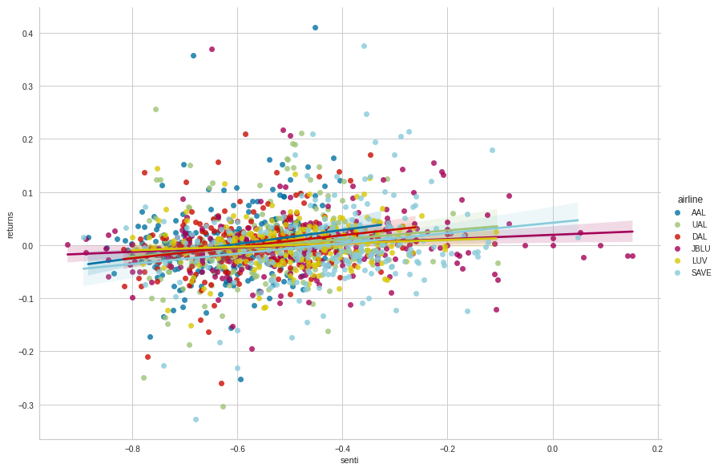
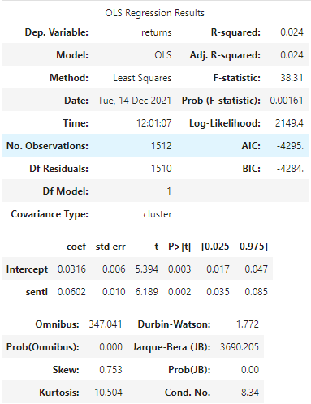
Twitter Sentiment vs. Stock Price (Cont’d)
Positive correlation between sentiment and rolling cumulative returns of airline stock price

Slide 14
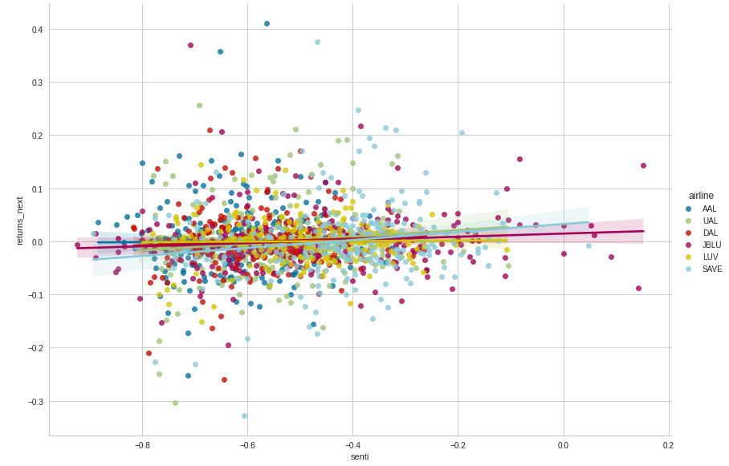
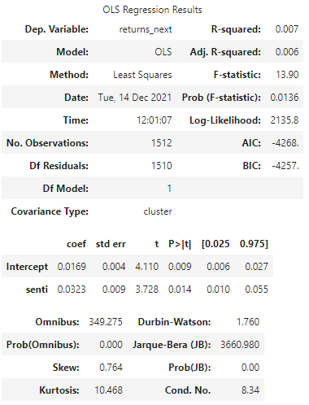
Twitter Sentiment vs. Stock Price (Cont’d)
Regression plot of the rolling daily returns and sentiment also shows a positive correlation, though less evident than the previous model

Slide 15
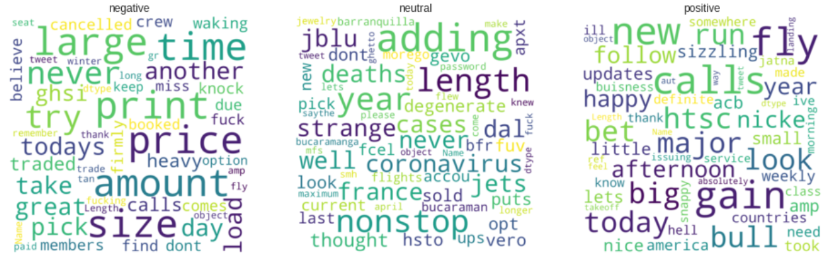
Word Clouds
Negative words: “price”, “time”, “miss”, “never”, “cancelled”
Positive words: “new”, “gain”, “thank”, “bull”

